Slide 1
Lesson 1 - Introduction to CSS
Mr Mack 2019

Slide 2
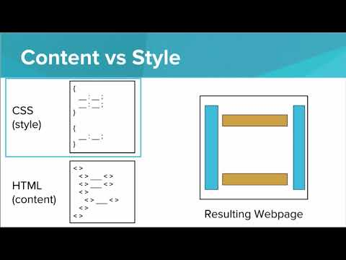

Slide 3
Why do we use CSS?
HTML wasn’t intended to be able to style web pages, CSS allows us to add style
Separate the content of a web page from the design of a web page
Easily modify the look and feel of a web site even at a large scale
All of the above

Slide 4
Which of the following is a valid CSS rule?
h1 {
color: blue;
}
style="color:blue;"
css="color:blue;"
h1 {
color {
blue;
}
}

Slide 5
Example: Styling your H1s
This is an example for this lesson. You are encouraged to play around with it, run and change the code, and learn how it works. When you are done, click continue to go to the next problem.

Slide 6
Exercise 3.1.1: First style with CSS
Modify the CSS style of this page so that the h1 tags are green and the li tags have a font size of 18px.

Slide 7
Exercise 3.1.2: List Styling
Remember how tedious it was to type out the style attribute to set the background color for every single tag that you wanted to style?
In this exercise, you’ll use CSS to style each tag for the music festival announcement with only a single line of code.
STARTER CODE
The given web page shows a music festival announcement.
The body has background color of LightBlue
The h1 tags have a background color of LawnGreen
The ul tags have a background color of Sienna
YOUR JOB
Add the following styles to the specified tags:
Add the background color “LightYellow” to the h2 tags
Add the background color “Orchid” to the ol tags
Make the li tags have a font size of 20px (Hint: use the attribute font-size)

Slide 8
Exercise 3.1.3: Endangered Animals: Skeleton
Quickly choose four animals from this list:
https://en.wikipedia.org/wiki/United_States_Fish_and_Wildlife_Service_list_of_endangered_species_of_mammals_and_birds
Create Content
Make a page that contains an <h2> header with each animal’s name.
Under each header, put an unordered list that states
its scientific name
where the animal lives
if it is “endangered” or “threatened”
All of this information can be found in the table on the provided website.
Make sure to choose at least one endangered animal and one threatened animal.
Set the Style
Modify the body style to set the background-color to #FFD1AA. Set the font-size to 18px.

